Slide 1
Capstone Project Google Data Analytics Certificate
File created on: 3/1/2024
By: Talha Talat

Slide 2
How does a bike-share navigate speedy success?
I am working for a company, Cyclistic, along with some key team members. To answer the business questions, I followed the steps of the data analysis process: Ask, Prepare, Process, Analyze, Share, and Act.
Problem: The director of marketing believes the company’s future success depends on maximizing the number of annual memberships. Therefore, my team wants to understand how casual riders and annual members use Cyclistic bikes differently.
Solution: From these insights, I will design a new marketing strategy to convert casual riders into annual members. But first, Cyclistic executives must approve my recommendations, so they must be backed up with compelling data insights and professional data visualizations.

Slide 3
Team
Cyclistic: A bike-share program that features more than 5,800 bicycles and 600 docking stations. Cyclistic sets itself apart by also offering reclining bikes, hand tricycles, and cargo bikes, making bike-share more inclusive to people with disabilities and riders who can’t use a standard two-wheeled bike. The majority of riders opt for traditional bikes; about 8% of riders use the assistive options. Cyclistic users are more likely to ride for leisure, but about 30% use bikes to commute to work each day.
Lily Moreno: The director of marketing and your manager. Moreno is responsible for the development of campaigns and initiatives to promote the bike-share program.
Cyclistic marketing analytics team: A team of data analysts who are responsible for collecting, analyzing, and reporting data that helps guide Cyclistic marketing strategy. You joined this team six months ago and have been busy learning about Cyclistic’s mission and business goals—as well as how you, as a junior data analyst, can help Cyclistic achieve them.
Cyclistic executive team: The notoriously detail-oriented executive team will decide whether to approve the recommended marketing program.

Slide 4
Goal
Moreno has set the goal to determine and figure out the ratio of Casual riders vs Annual Member Riders, and to find out the way on how to convert the Casual Riders into Annual Members.

Slide 5
Ask
1. How do annual members and casual riders use Cyclistic bikes differently?
2. Why would casual riders buy Cyclistic annual memberships?
3. How can Cyclistic use digital media to influence casual riders to become members?

Slide 6
Report
The business task is to understand how the members and casual riders model differentiates the usage of cycles in different areas, and on which day of the week.
For this Project, I will be using Excel, and MySQL for data cleaning, and integrating, and Tableau for Data Visualization.

Slide 7
Data Gathering & Cleaning & Integrating
First I downloaded the data from the given link, which included 12 months of previous data of 2023.
I opened these 12 excel files, and did some cleaning by filtering ride_id, start_station_name, and started_at. I deleted blanks, and duplicated data, and then corrected some more data.
After cleaning, I calculated ride_length in a separate column, which included the difference between started time and ended time.
I calculated the day_of_the_week, in which the rides were booked by riders.
I saved these excel files again, and converted them to csv files to later upload them into MySQL Database to engage with more information.

Slide 8
MySQL Data Insights
In MySQL, my first step was to Install all the tables in the schema, and So I did by writing the following script:
USE cyclistic_bike_data;
CREATE TABLE 202312_december(
ride_id TEXT,
rideable_type TEXT,
started_at datetime,
ended_at datetime,
start_station_name TEXT,
start_station_id TEXT,
end_station_name TEXT,
end_station_id TEXT,
start_lat double,
start_lng double,
end_lat double,
end_lng double,
member_casual Text);
SELECT *FROM 202312_december;
LOAD DATA INFILE '202312-divvy-tripdata.csv' INTO TABLE 202312_December
FIELDS TERMINATED BY ‘,’ IGNORE 1 Lines;

Slide 9
Next I used the Union function in MySQL to union all the tables imported.
I did some calculations such as finding max_ride_length, min_ride_length, mean_ride_length, and finding counts of both the rider types in different starting areas.
SELECT *
FROM cyclistic_bike_data.2023_divvy_tripdata1;
After completing SQL, I imported the same files on Tableau Desktop 2024.1.
I then created data visualizations based on the data I found in query, and on dashboard.

Slide 10
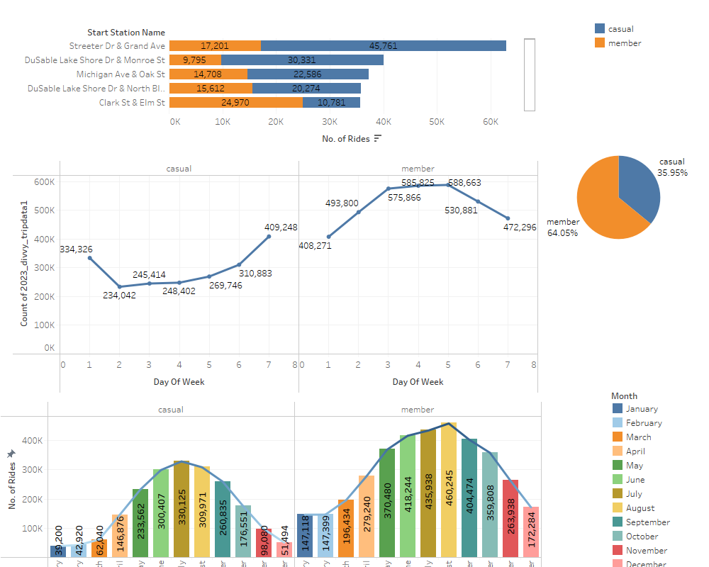

Slide 11
Data Visualization
The Dashboards illustrate some important data.
Top 5 Starting station names with differentiating in Members and Casuals Rider.
Total Percentage of MemberVsCasual.
The usage of cyclistic rides for each day of the week by members and casuals.
The usage of cyclistic rides for each month by members and casuals.

Slide 12
Key Trends
The first graph, shows the total number of riders from the top 5 starting stations, and it shows that in the top 4 riding stations, there are more casual riders than member riders.
The Pie chart shows the total percentage of member riders is greater than the total percentage of casual riders.
The third chart shows that, for casual riders, the most number of rides are booked during the weekend or on the 7th day, which is Sunday, and for member riders, the most no. of rides they take are during weekdays, which are the working days of the week.
The fourth graph shows that most rides are booked from the month of May to the month of September, and since it is the summertime and the best time of the year to cycle.

Slide 13
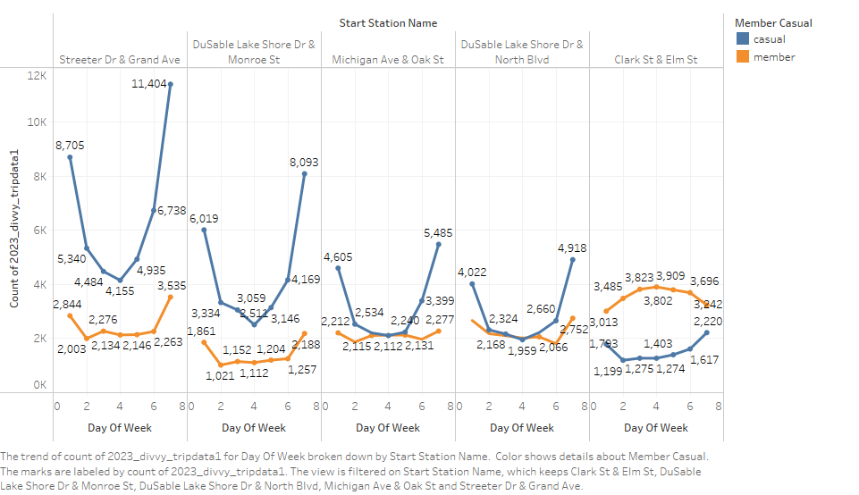
Top 5 Stations Weekly Rides Book

Slide 14
Recommendation
Firstly, there is no need to make more effort, since the numbers of total number members are higher than the total number of casual riders.
Secondly, we can target the areas of the station, where casuals are taking more rides than the members as shown in the graph, by starting advertising in these areas, and offering some discount for membership, since the casuals are booking more rides.
We can offer some special discounts for casual riders, who want to book their rides for the weekend and ask them to join the membership to avail that discount and it will be specifically to those areas only.

Slide 15
Final Comments
If we take action on the following points, then we can start to see an increase in the number of members closer to 80% at least, and witness the rise of the company.

